Slide 1






PregART-Clinical Trial
https://www.pregart.eu

Slide 2
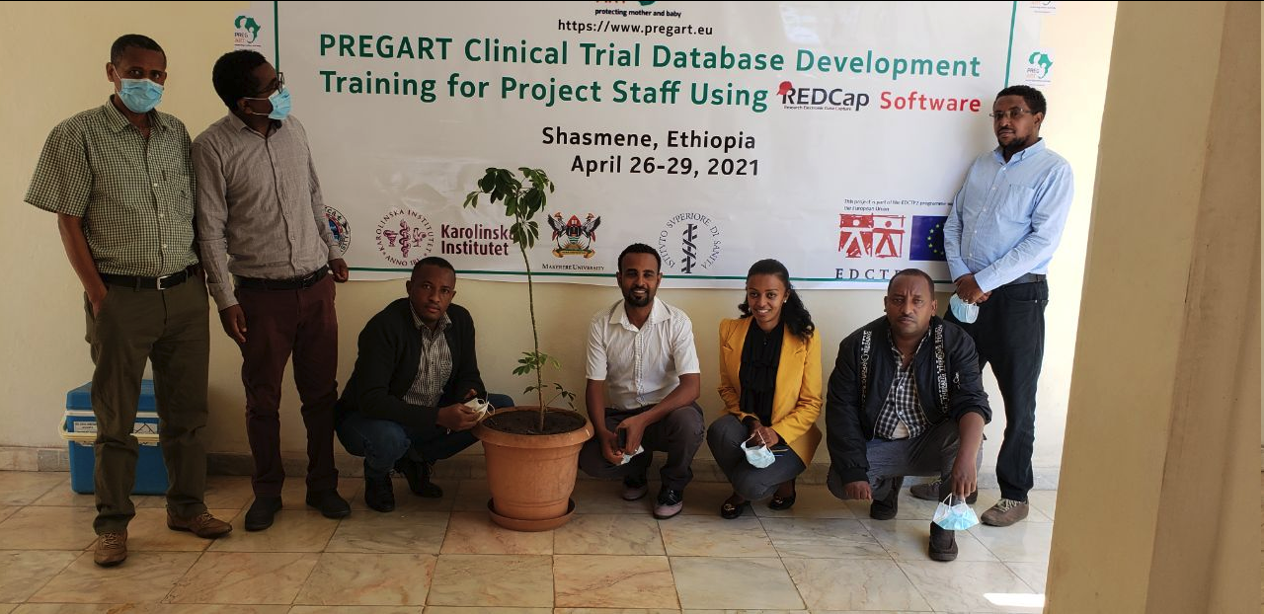
Training on REDCap Data Management Software
April 2021
Biruk Supervisor
Dr. Abel Investigator
Dr. Dejene HU Coordinator & Investigator
Sintayehu Project Manager
Siraj Laboratory Coordinator
Negede Supervisor
Wondwossen Trainer
PregART Clinical Trial-HU Staff

Slide 3
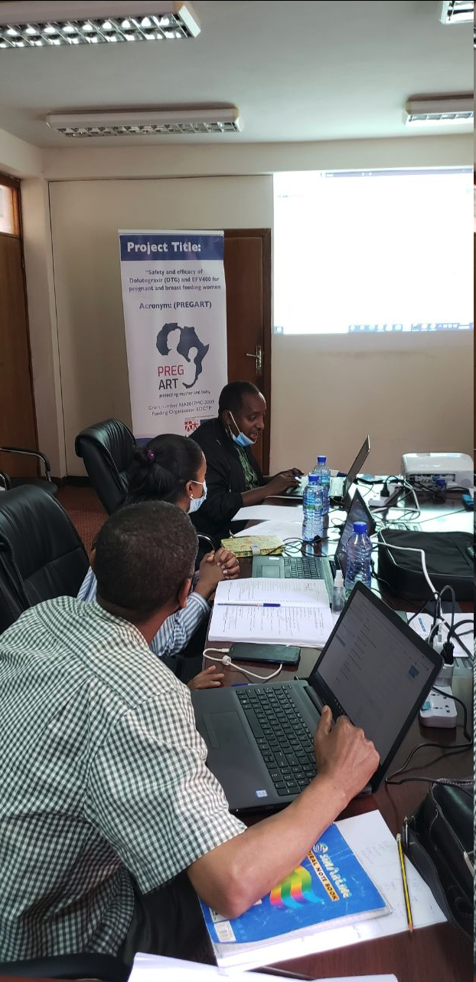
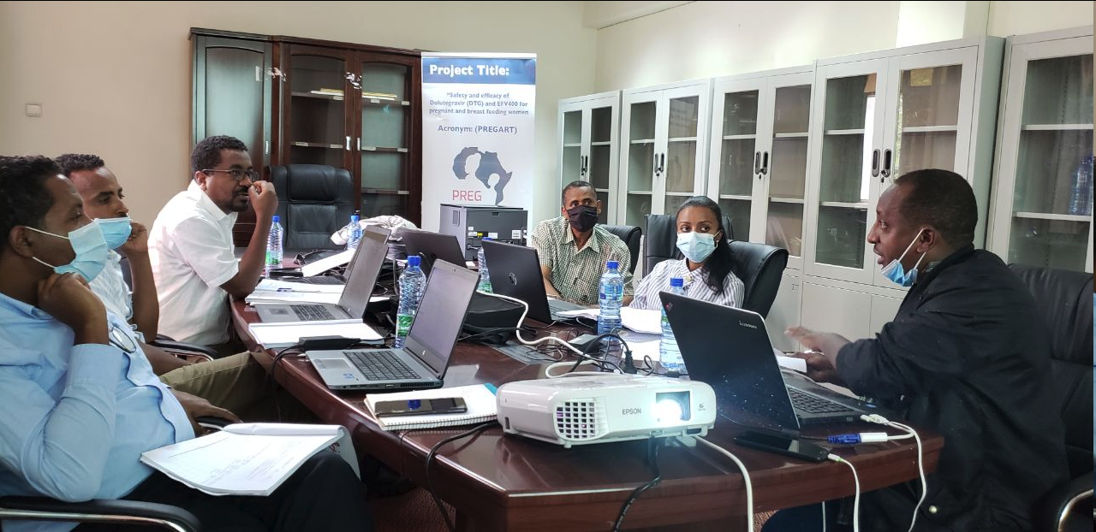
Objective of the Training:
Aimed to capacitate the research team and project staff on application of REDCap software on PREGART projects data entry and reporting so that the program will generate a high quality data for the project.
REDCap Trainer:
Expert in REDCap from Ethiopia Public Health Institute (EPHI)

Slide 4
Main Contents Covered in the Training:
Introduction to data, data quality, data quality dimensions
Introduction to REDCap software:
Definitions
Important terminologies relevant to REDCap
REDCap features
Getting started with REDCap software
Creating New eCRF
Access & editing eCRF
Exporting data from REDCap to other Software
Cont’d

Slide 5
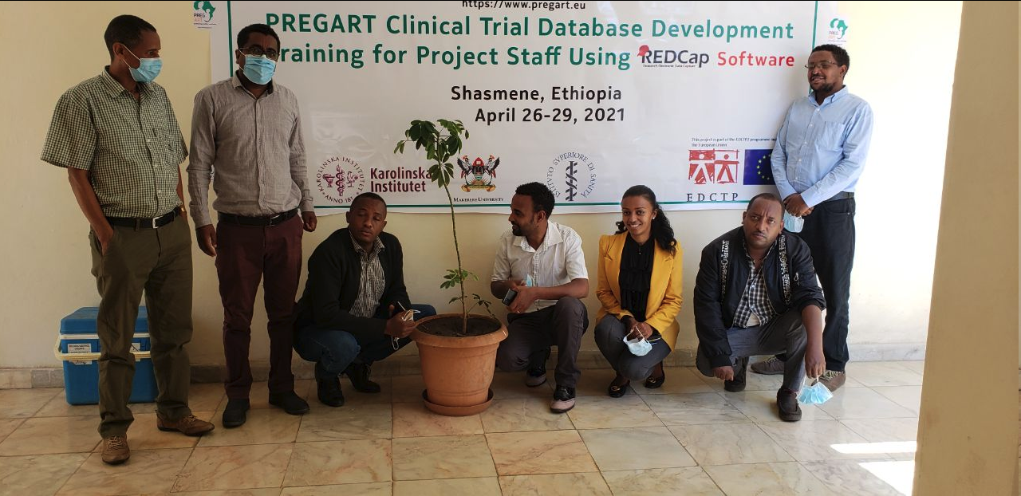
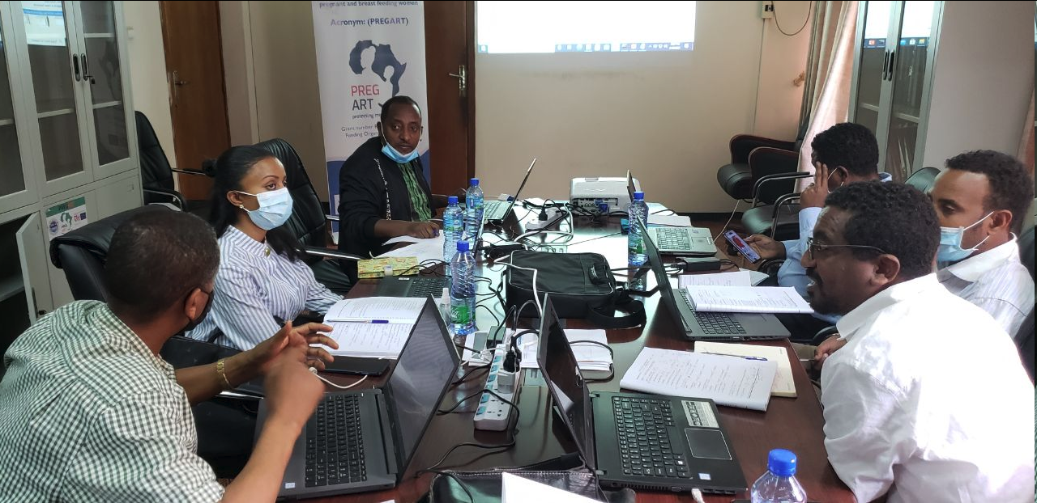
Cont’d
PRACTICAL SESSION
Included entering a fictitious data into the REDCap database.
Identify limitations and errors in the CRFs created in the REDCap software.
Identify data type as per the CRF
Save Data
Export Data variables
Edit and Save data dictionary (codebook)
Practical Session

Slide 6

Thank You
Hawassa, Ethiopia

